Slide 1
Group G
WEEK 7
Ryan Klugman
Bowei Liu
Isabel Barlow

Slide 2
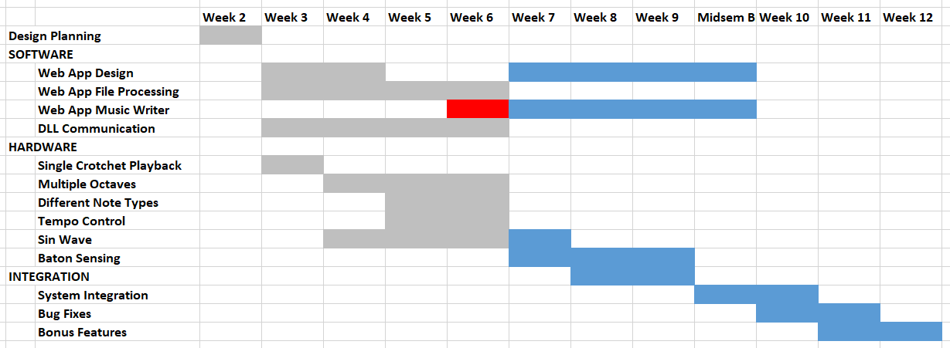
Gantt chart

Slide 3
Progress
On track on hardware side
Behind schedule on software side
Progress only occurs in weeks an individual is presenting
Poor git practice
Not committing regularly enough

Slide 5
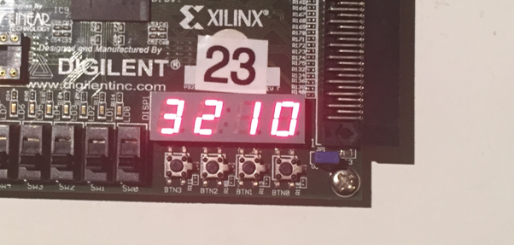
Progress: LCD
Can now display 4 digit number from 0000 – 9999
Could previously only control each digit individually
Needed for displaying tempo in BMP
Very useful for debugging
Can use as “print” statements

Slide 6
Progress: Music Playback
Redesigned entire module
Abstracted note length counter and note pitch player into two separate subcomponents
Music Player
Note Length Counter
Note Pitch Player

Slide 7
TOP LEVEL
entity music_player is
port (
clk : in std_logic;
btn : in std_logic_vector(3 downto 0);
sw : in std_logic_vector(7 downto 0);
led : out std_logic_vector(7 downto 0);
s : out std_logic );
end music_player;

Slide 8
Note LENGTH COUNTER
component note_length_counter is
port (
rst : in std_logic;
clk : in std_logic;
is_staccato : in std_logic;
is_slurred : in std_logic;
note_length_in_twelfths : in natural range min_note_length_in_twelfths to max_note_length_in_twelfths;
twelfth_cc : in natural range min_twelfth_cc to max_twelfth_cc;
is_mute : out std_logic;
is_new_note : out std_logic);
end component;

Slide 9
Note Durations
Duration | Length in Beats | Length in Twelfths
Semiquaver | 1/4 | 3
Tuplet | 1/3 | 4
Quaver | 1/2 | 6
Dotted Quaver | 3/4 | 9
Crotchet | 1 | 12
Dotted Crotchet | 3/2 | 18
Minim | 2 | 24
Dotted Minim | 3 | 36
Semibreve | 4 | 48
Breve | 8 | 96

Slide 10
Note LENGTH COUNTER
component note_length_counter is
port (
rst : in std_logic;
clk : in std_logic;
is_staccato : in std_logic;
is_slurred : in std_logic;
note_length_in_twelfths : in natural range min_note_length_in_twelfths to max_note_length_in_twelfths;
twelfth_cc : in natural range min_twelfth_cc to max_twelfth_cc;
is_mute : out std_logic;
is_new_note : out std_logic);
end component;

Slide 11
NOTE PITCH PLAYER
component note_pitch_player is
port (
rst : in std_logic;
clk : in std_logic;
note_pitch_cc : in natural range min_note_cc to max_note_cc;
note_pitch_pulse : out std_logic);
end component;

Slide 12
Progress: Music Playback
Redesigned entire module
Abstracted note length counter and note pitch player into two separate subcomponents
Can now play different octaves, note types and tempos
No longer using a sine wave

Slide 13
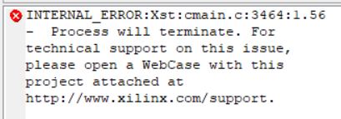
PROBLEMS
Sine tables make Xilinx take forever to compile
Reverted back to square wave temporarily
Length of music arrays cannot be above 15 notes
Not inferring block RAM?
Will try eliminating warnings

Slide 14
To Do Next Week
Fix music length bug
Incorporate sine wave into new music player
Start working on ultrasonic sensor
Web app music writer interface

